Slide 1
Ten Ways to Identify Young Gifted Children
El Dorado Gifted & Talented Department

Slide 2
Identification.
The process of finding students who have needs for or would benefit from advanced programming or services to develop their gifts and talents. Students with gifts and talents exhibit different characteristics, traits, and ways to express their giftedness; therefore, identifying students’ abilities and talents are essential to meeting their unique needs. The identification process moves from screening to placement (Matthews & Shaunessy, 2010) and involves the use of multiple measures to assess high-level ability, aptitude, achievement, or other constructs of interest in one or more areas or domains of learning (Johnsen, 2008a).

Slide 3
State of Arkansas Gifted Policy
Regular Classroom Teacher Responsibilities Include:
*Participating in professional development that helps identify and serve the unique needs of gifted students
*Providing appropriate educational opportunities for high ability students through differentiation
*Providing documentation of differentiation in those areas required by standards and program design

Slide 4
Myths: Early Childhood Gifted
ALL Children are Gifted!
The Gifted child is the one who is doing “The Best” in class.
Students with disabilities can’t be gifted.
Gifted students display their gifts immediately upon arrival to school
Gifted kids should help others who “Don’t Get It” or be role models.
GT kids are gifted in EVERY area.

Slide 5
10 Ways to Recognize Gifted Potential
Asynchronous development and/or self-critical behaviors.
Early use of advanced vocabulary, complexity, and humor.
Early literacy skills; interest in symbols.
Excellent memory; retention from varied sources.
Keen observation; curiosity, and inquisitiveness.
Intense interest in specific topics; concentration; perseverance; enjoys tinkering.
Strong critical thinking skills; organizational skills.
Creativity; imaginative capacity.
Ability to understand complex concepts; thinks abstractly.
Early demonstration of talents in music, art, athletics, or the performing arts

Slide 7
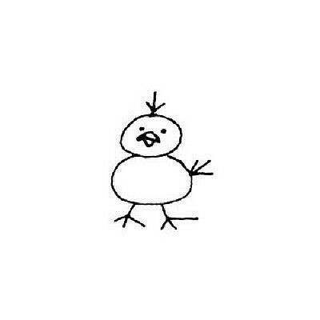
#2 Advanced Humor
Teacher gives assignment - “Draw a chicken”
GT Student (age 8) - “I don’t know how to draw a chicken
So I’m just going to “wing it”!

Slide 8
Early literacy/math skills
#3 Early Literacy Skills

Slide 9
#3 Early Mathematical Skills
https://www.youtube.com/watch?v=At-cmslNZBU

Slide 10
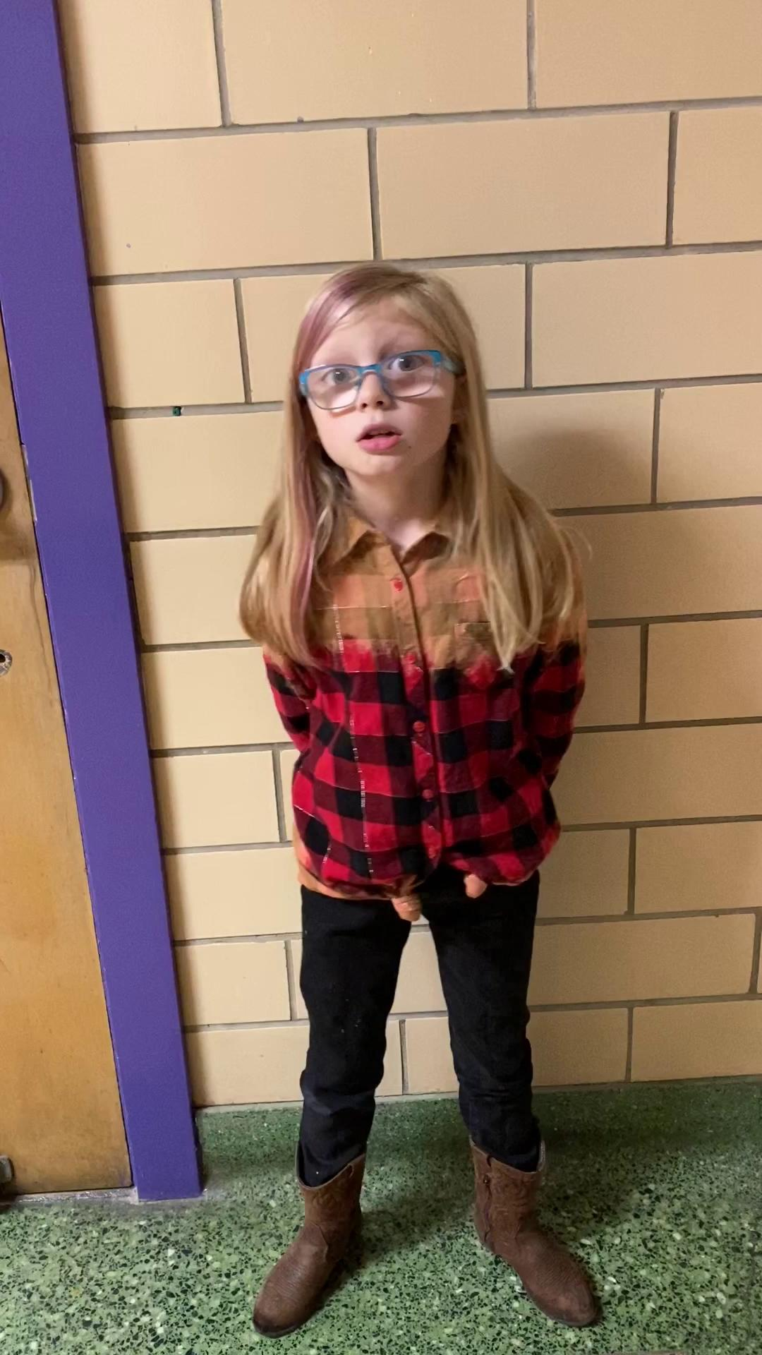
#4 Excellent memory; retention from varied sources.

Slide 11
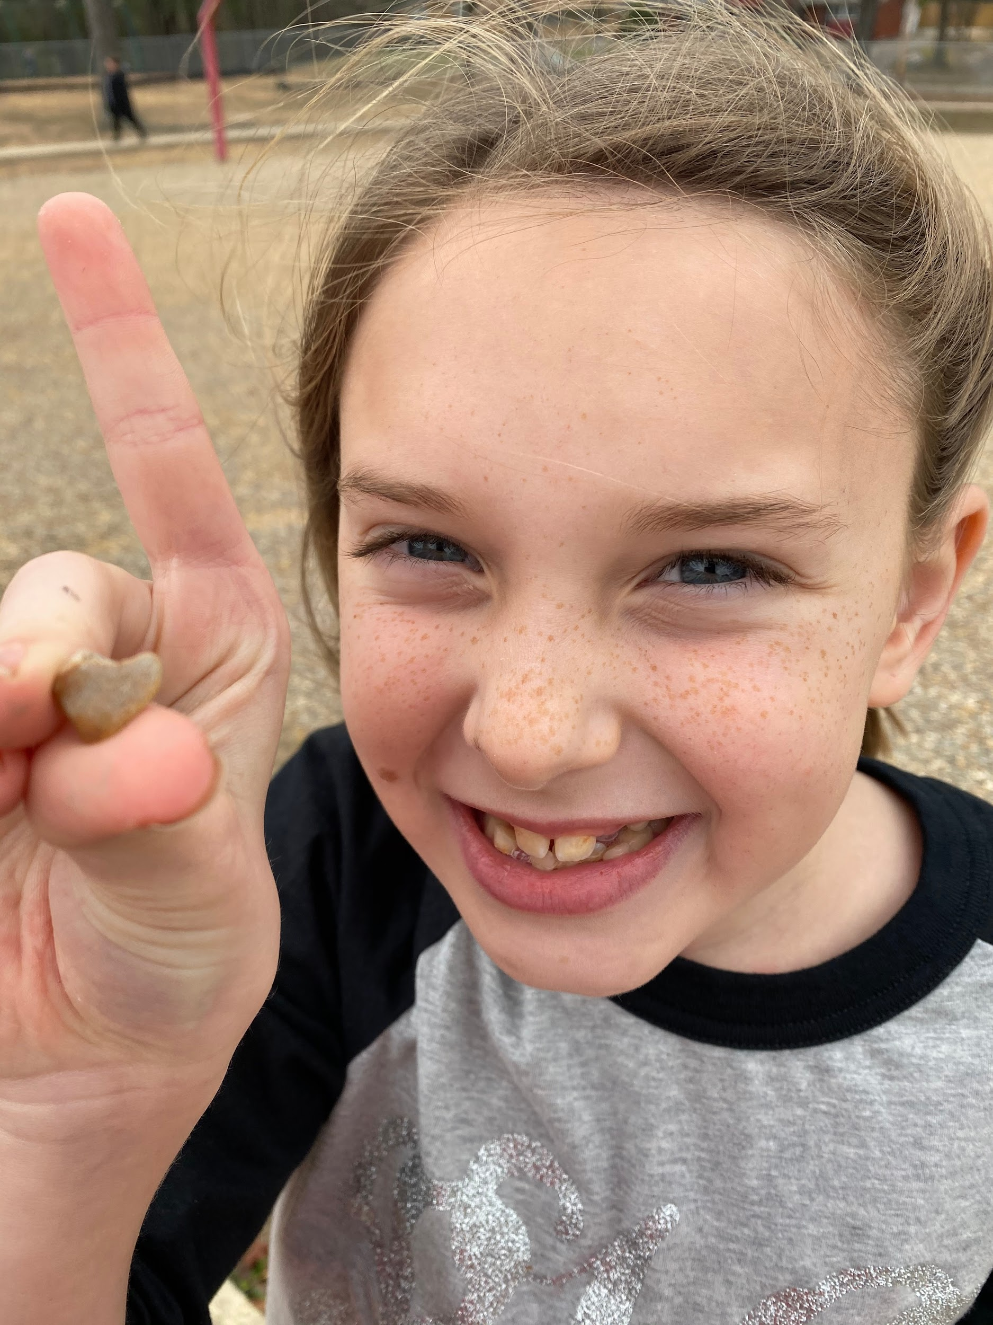
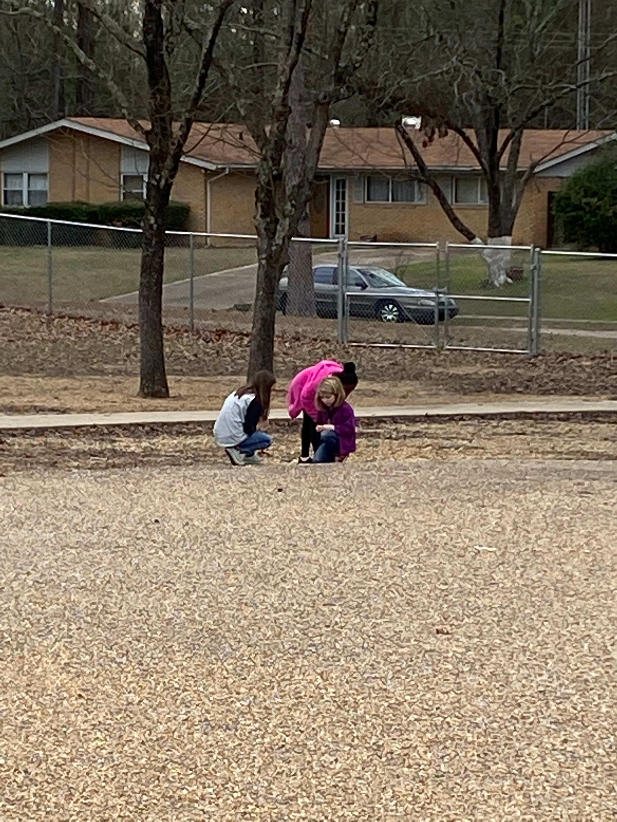
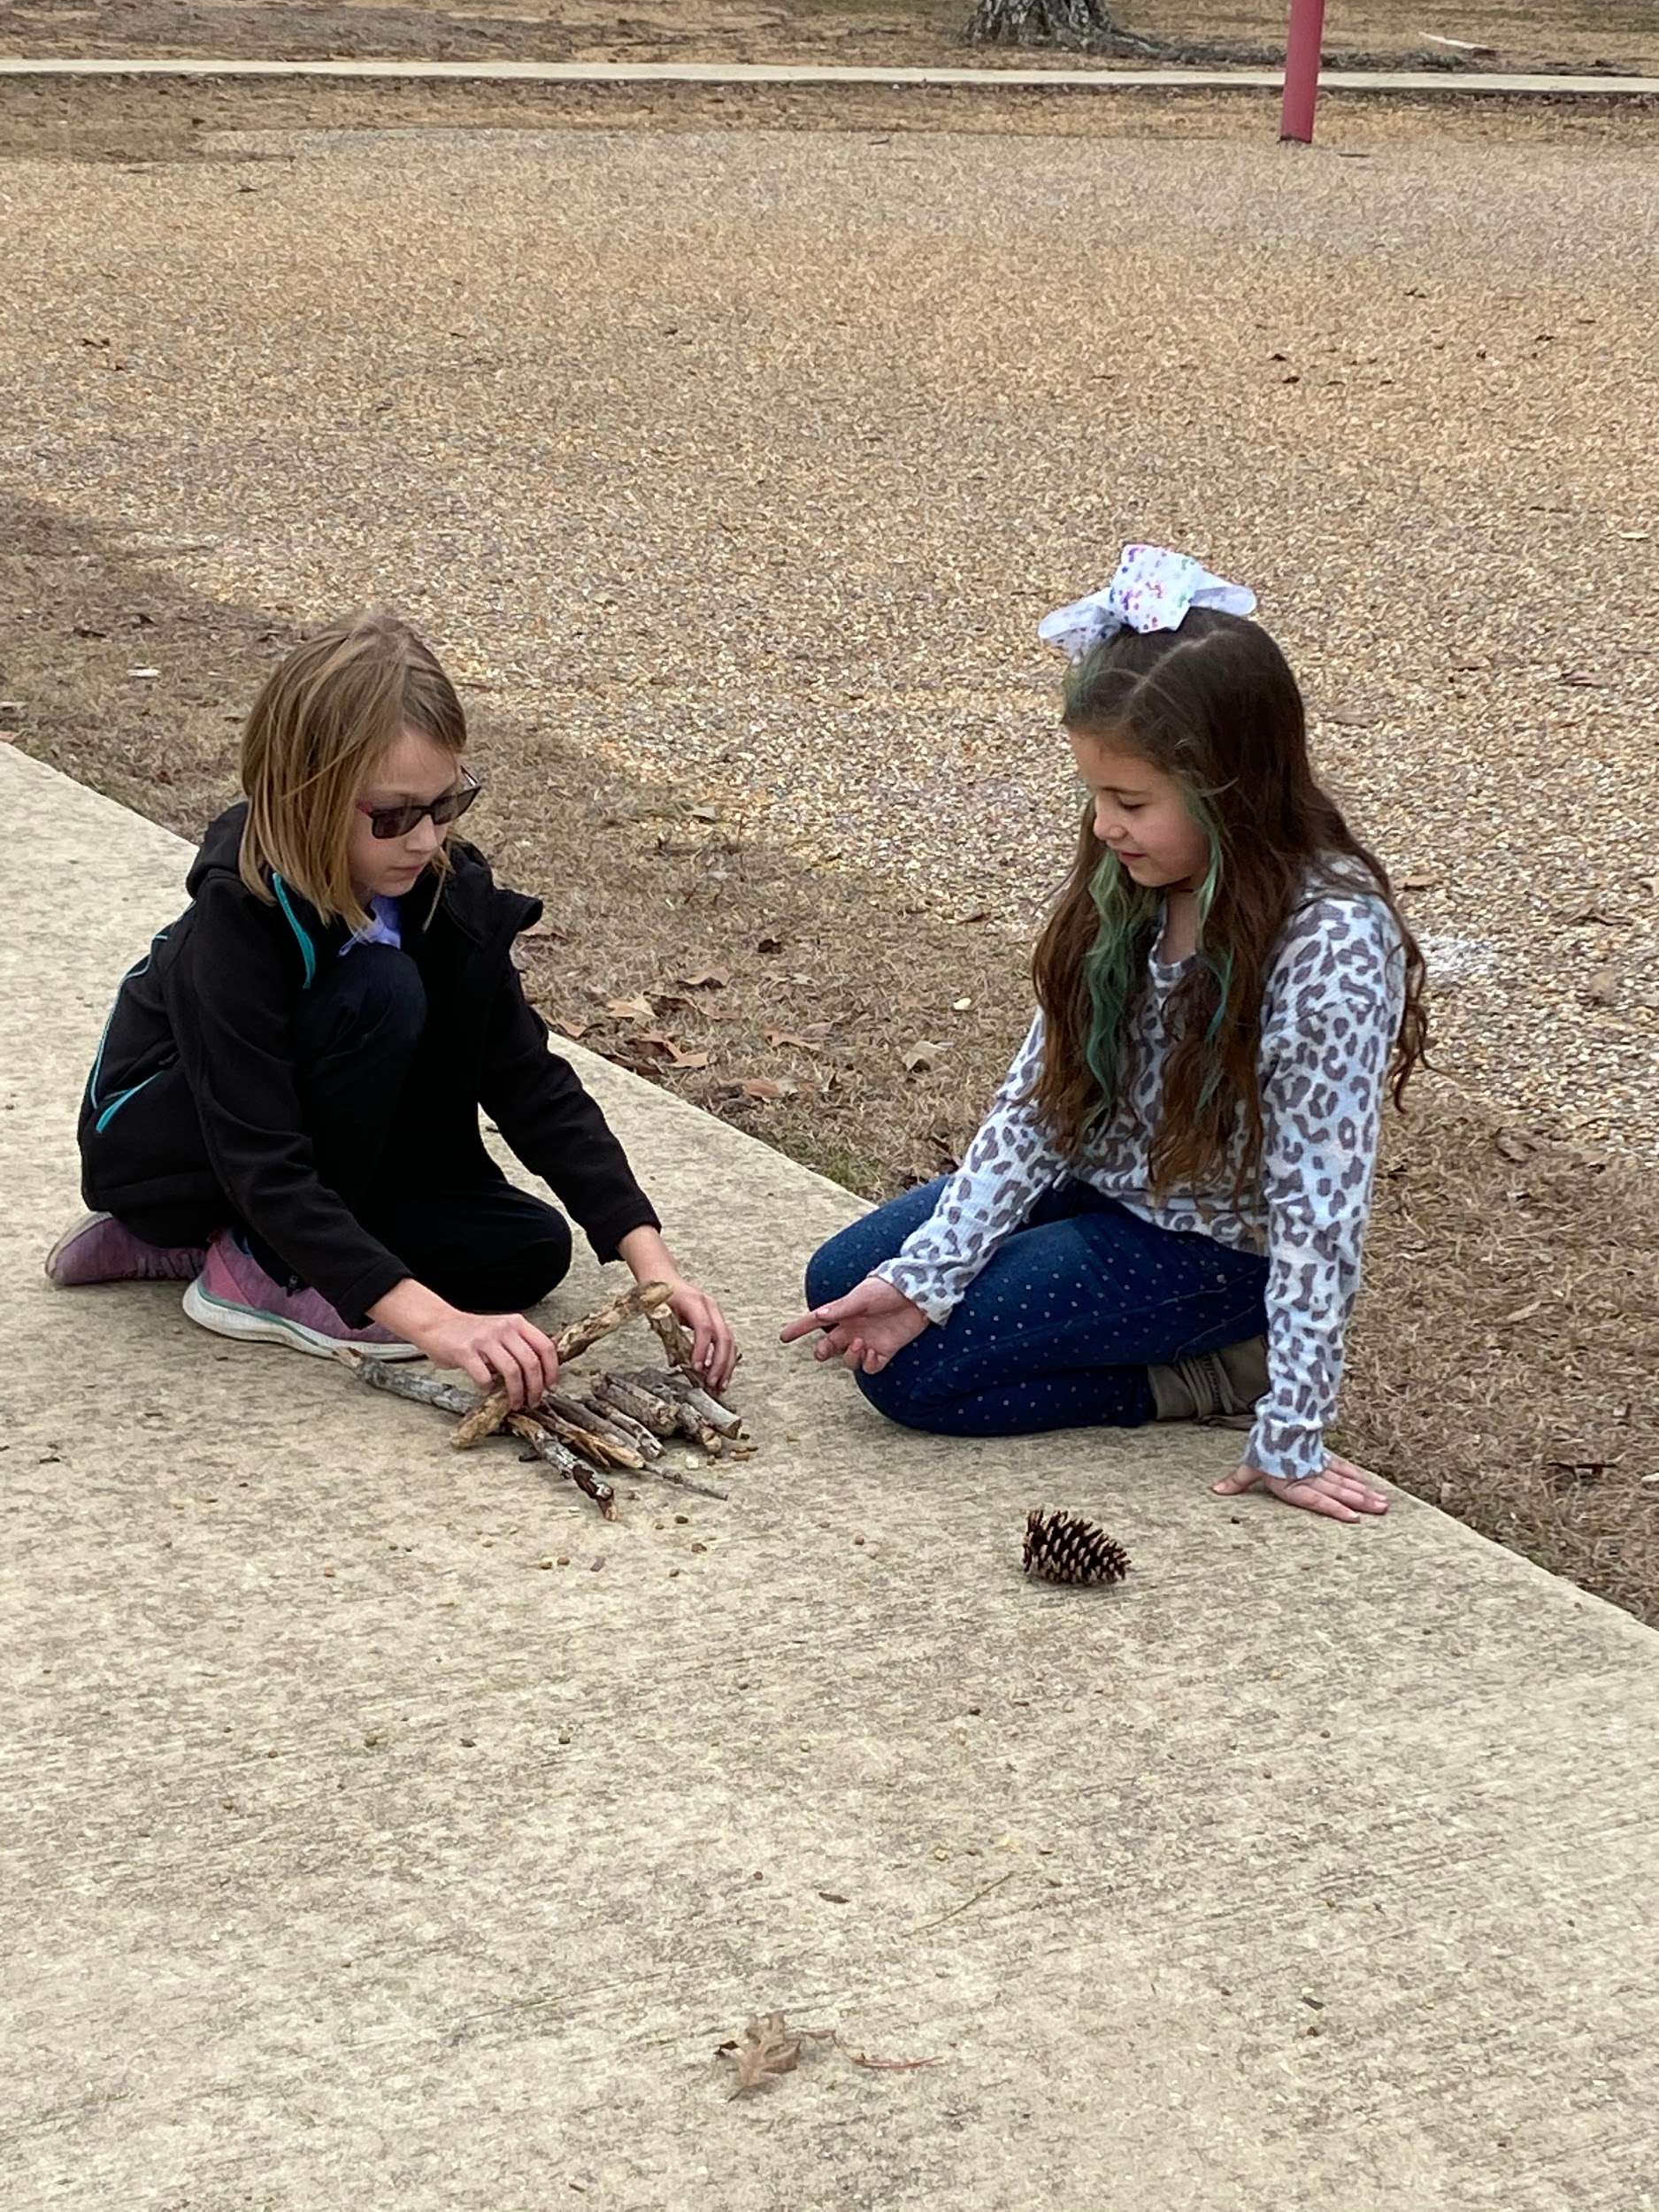
#5 Keen observation; curiosity & inquisitiveness
“Find me something shaped like a heart.” & “Build a house.”

Slide 12
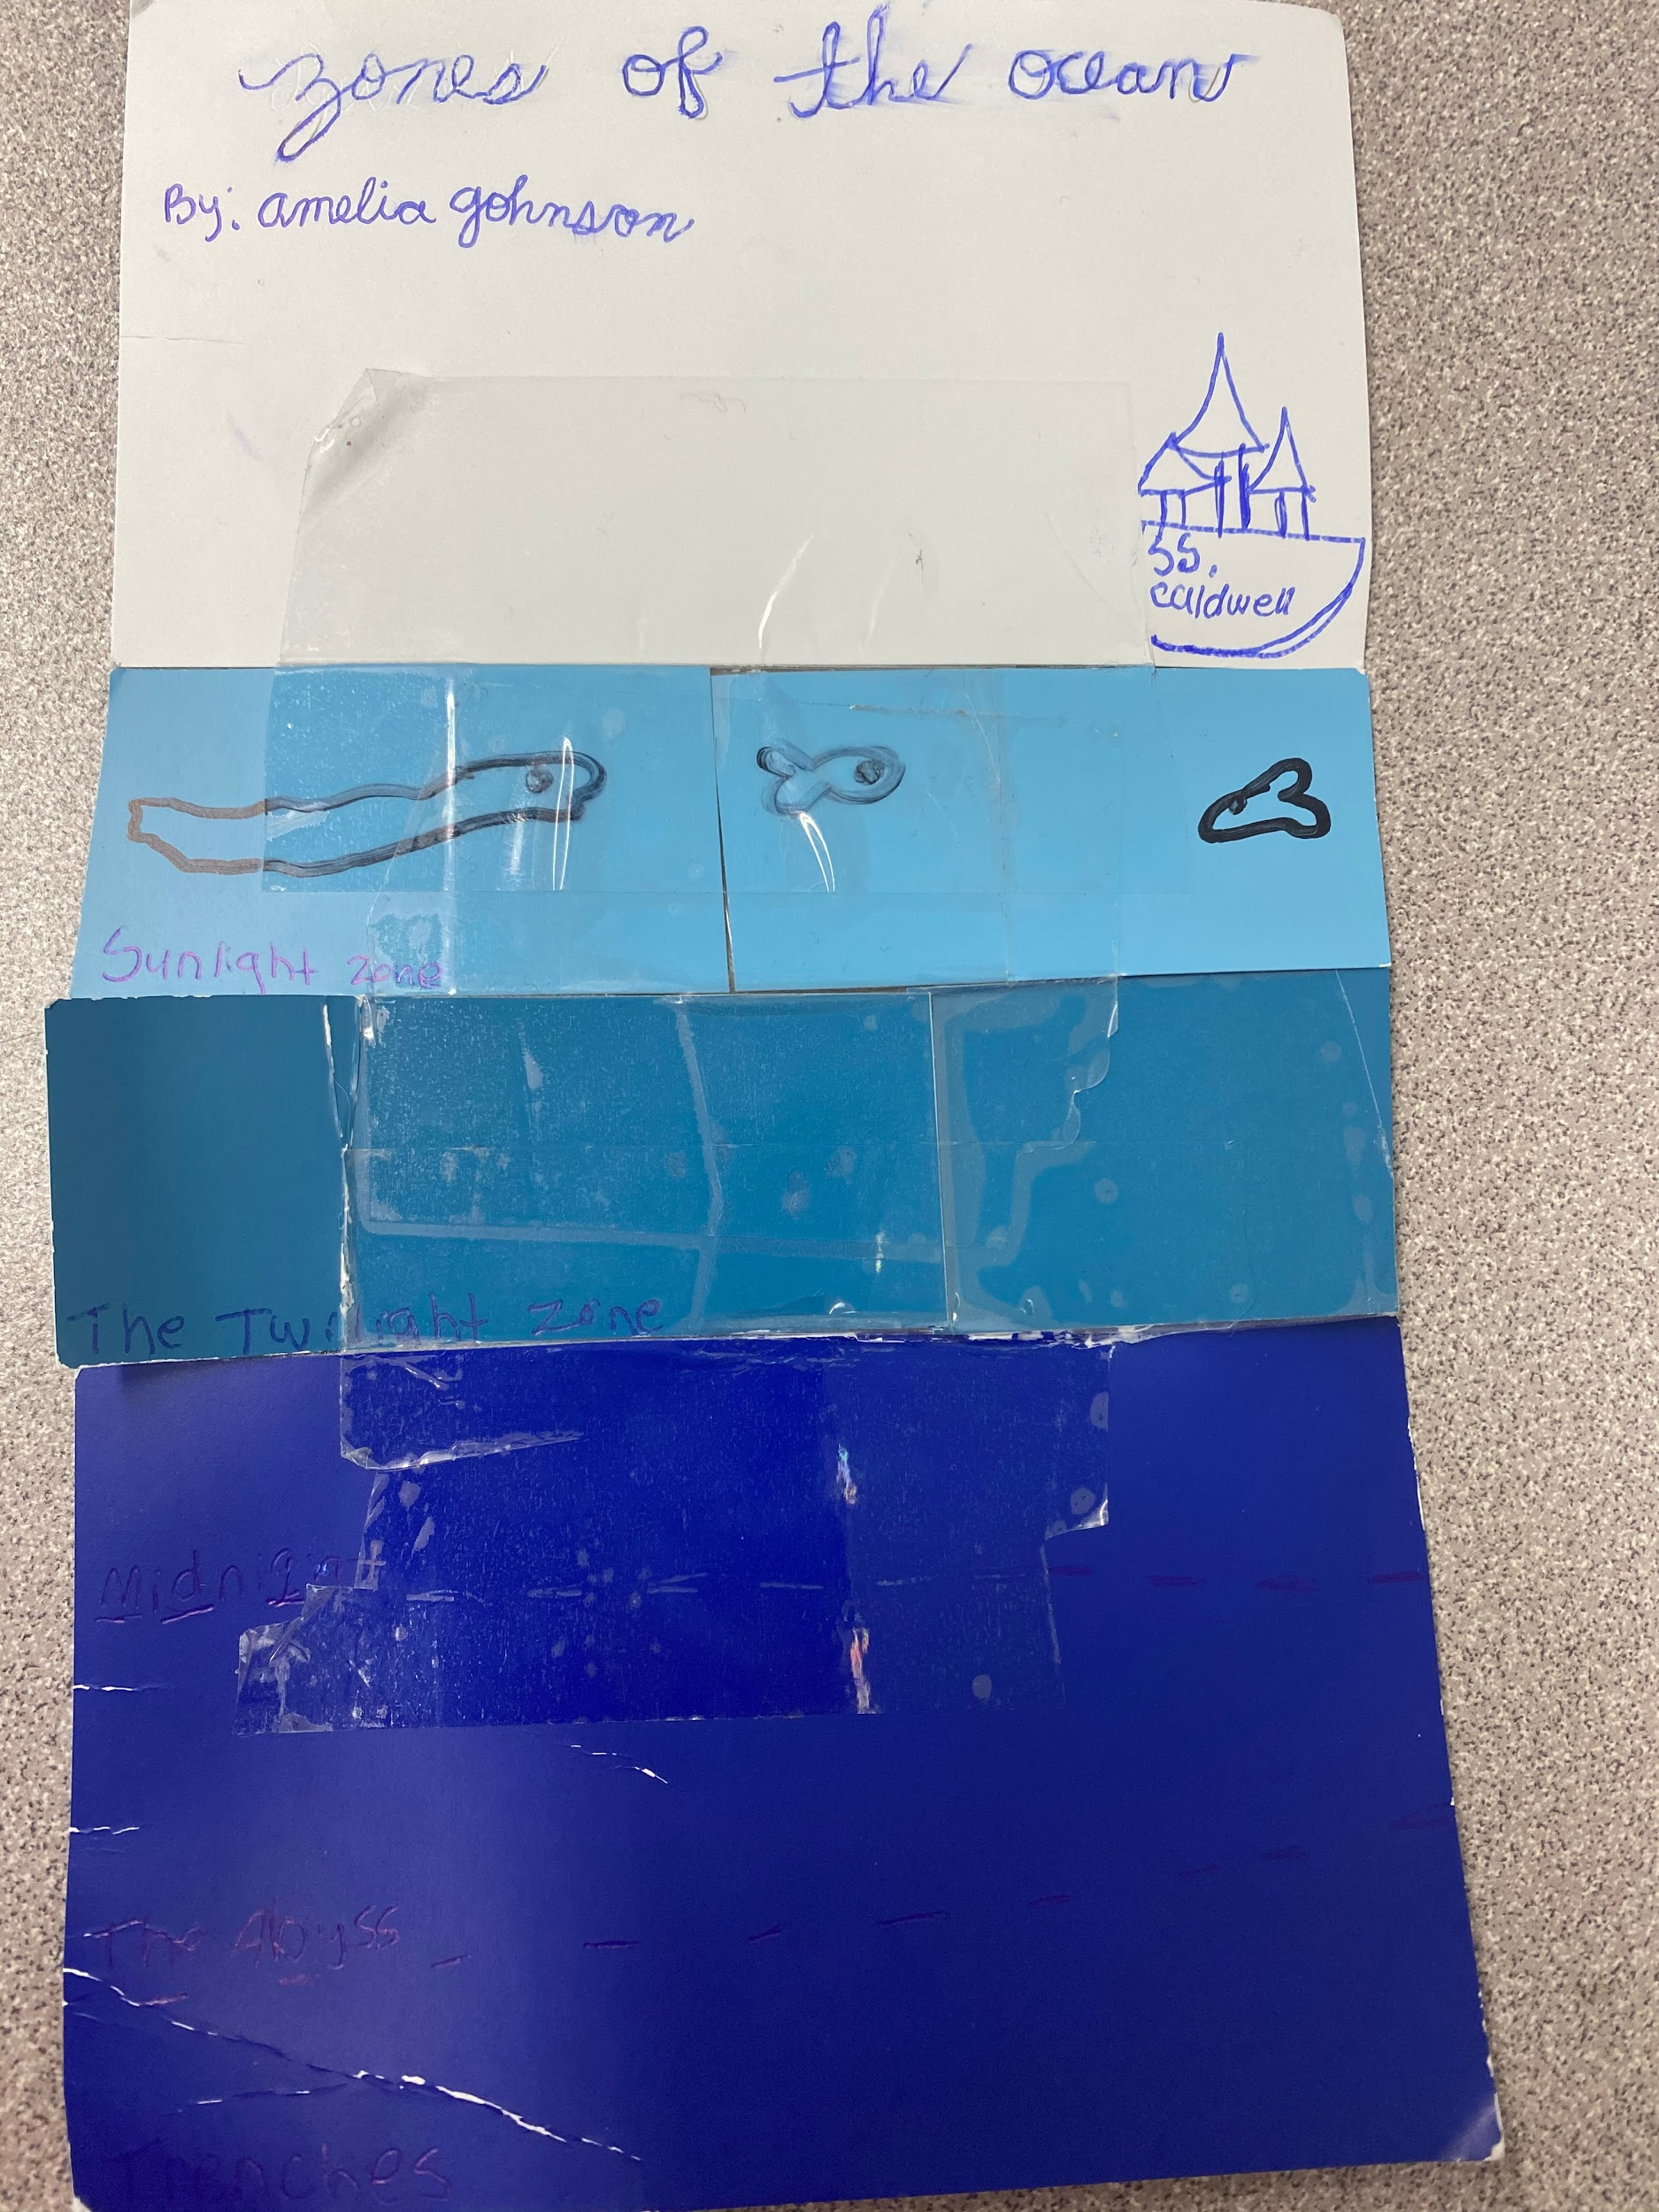
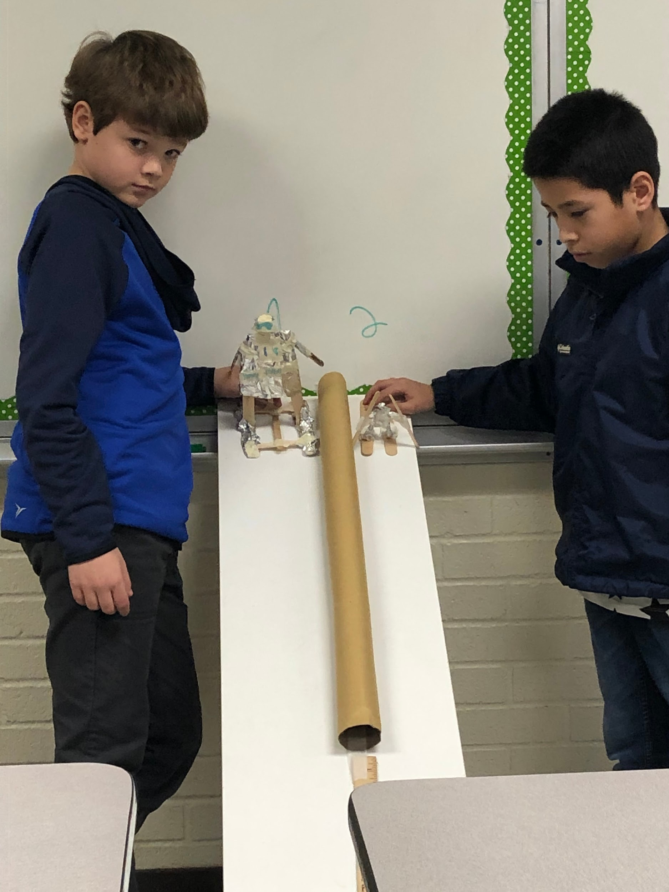
#6 Intense interest in specific topics; concentration; perseverance; enjoys tinkering.

Slide 13
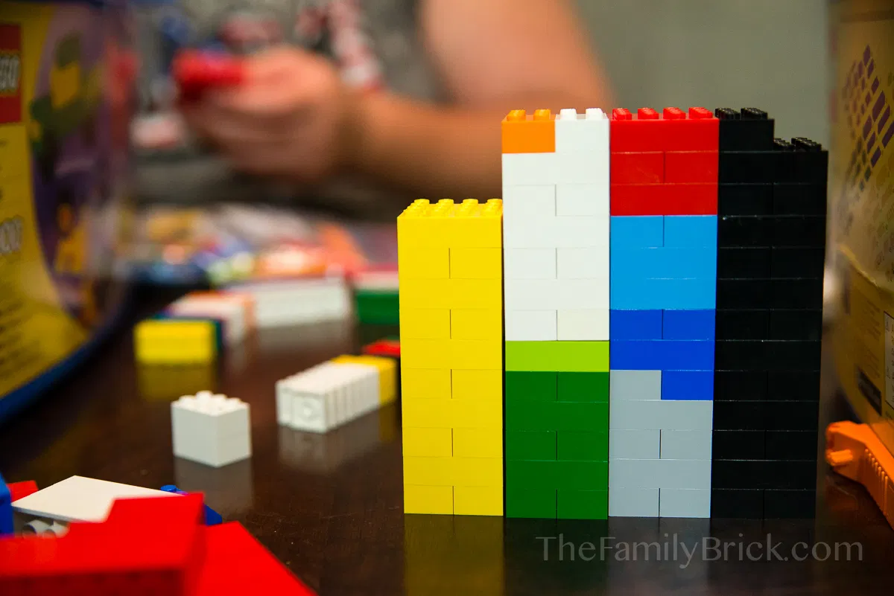
#7 Strong critical thinking skills; organizational skills.

Slide 14
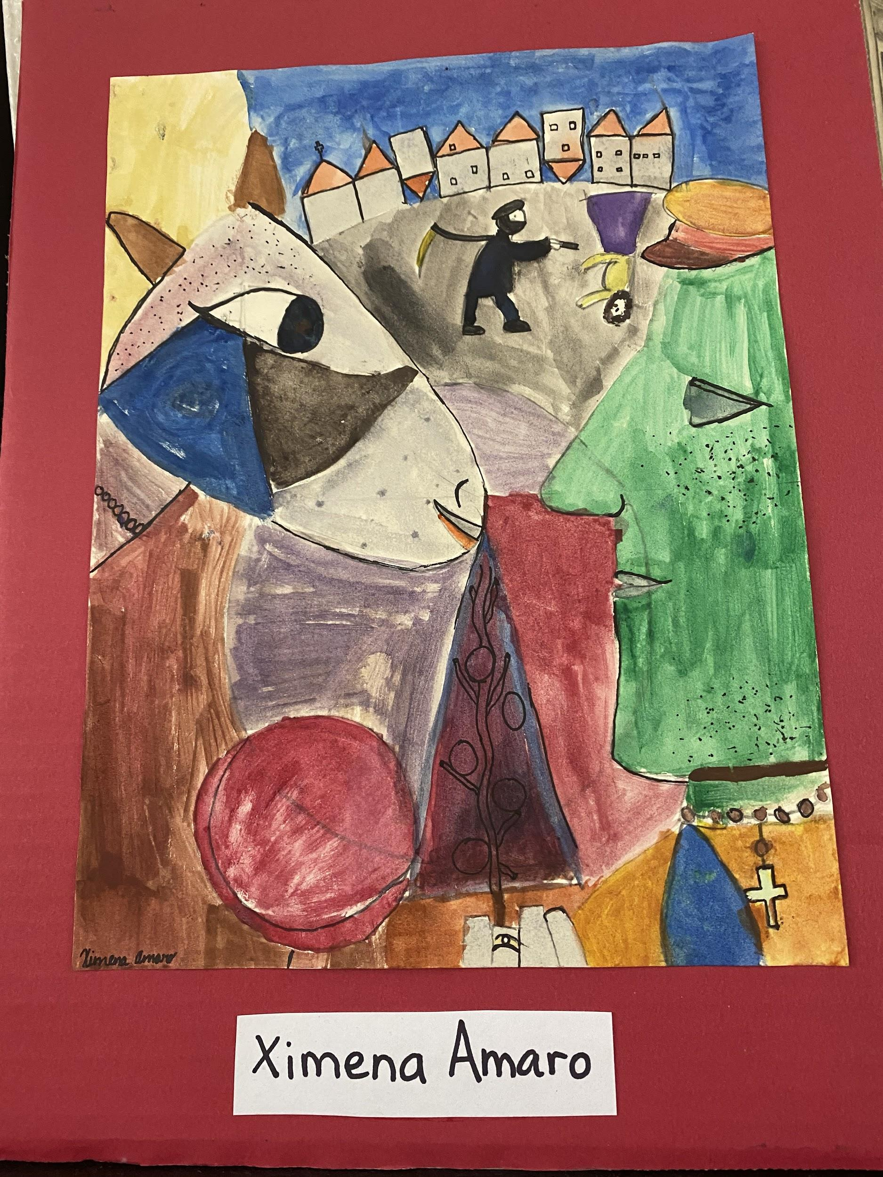
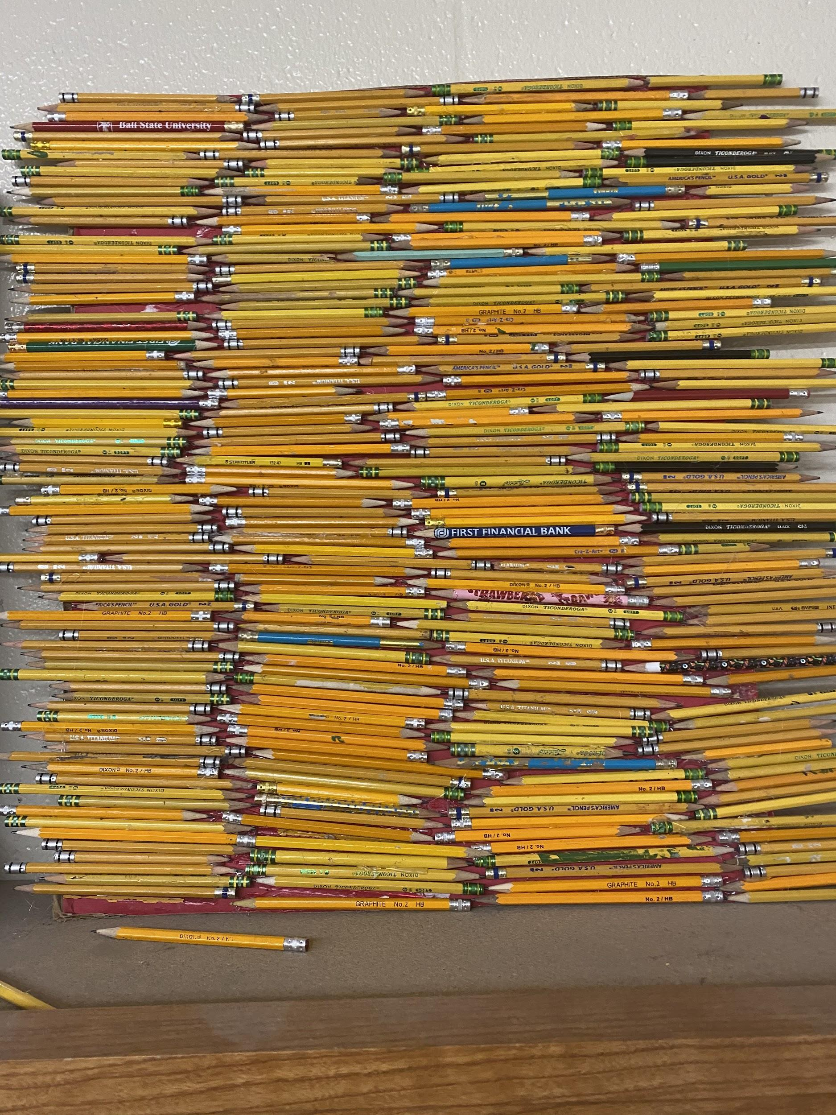
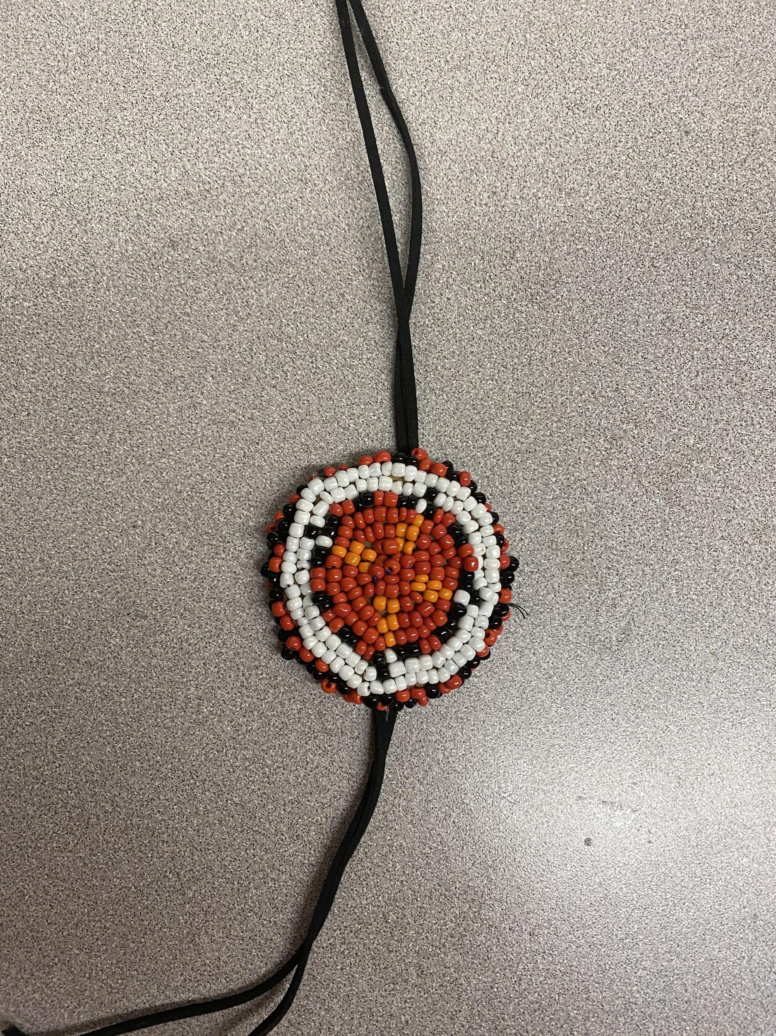
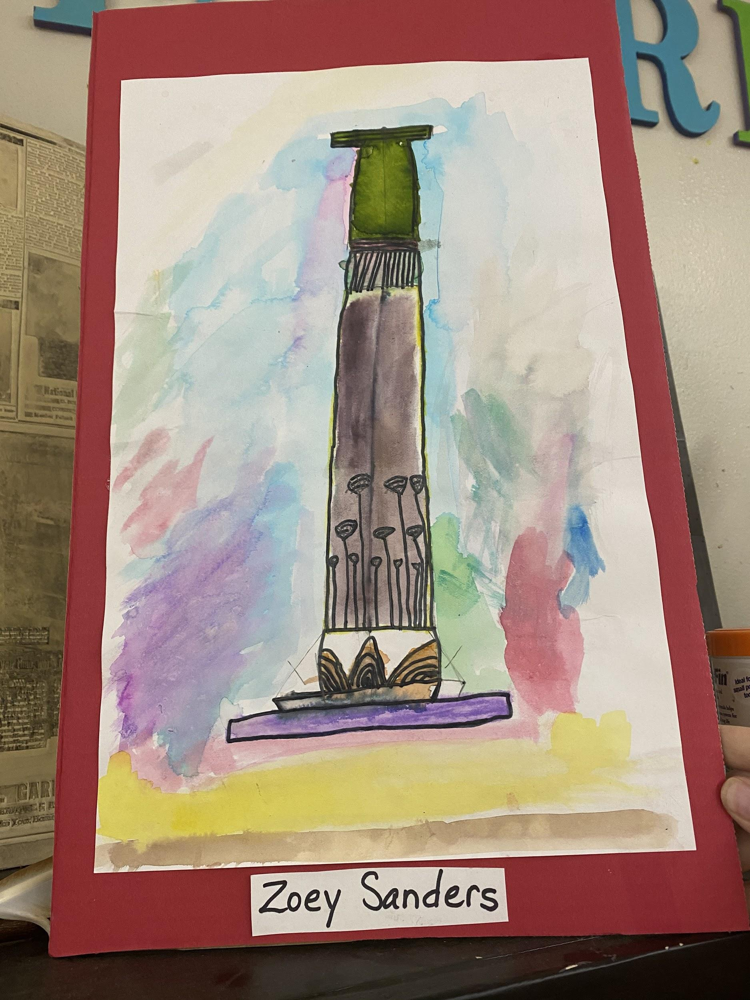
#8 Creativity; Imaginative Capacity

Slide 15
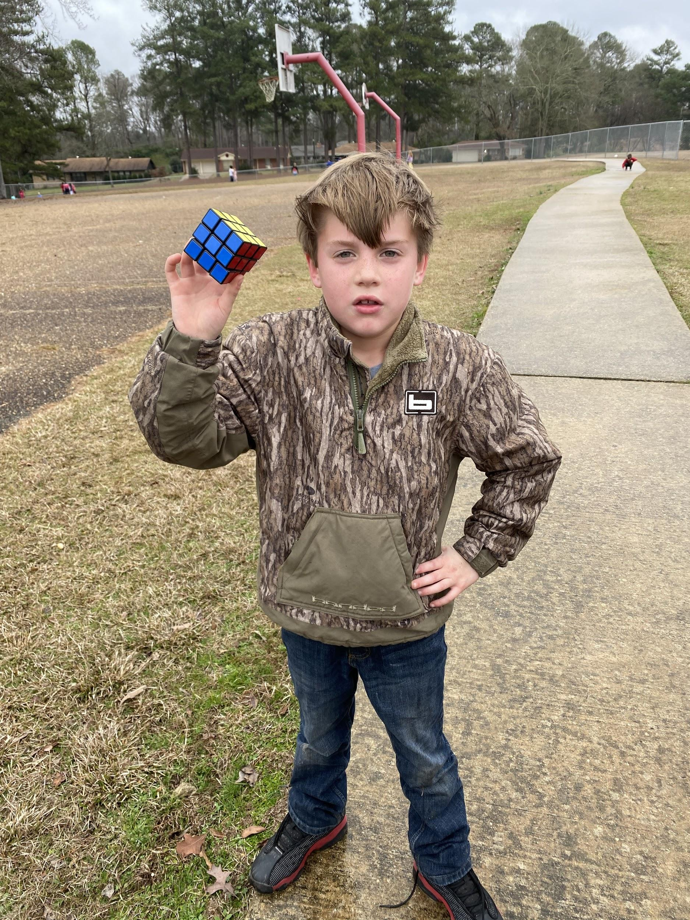
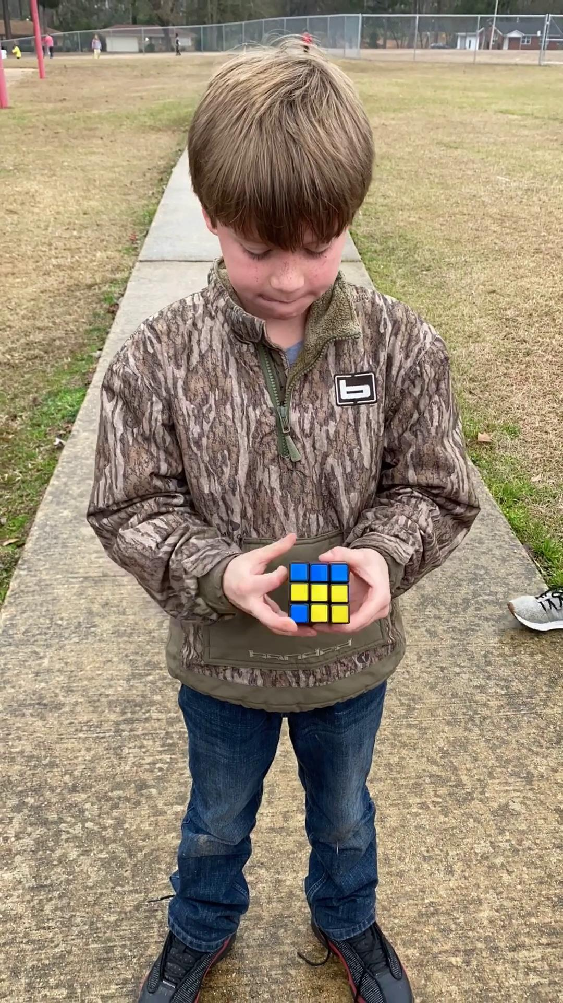
9. Ability to understand complex concepts; thinks abstractly.

Slide 16
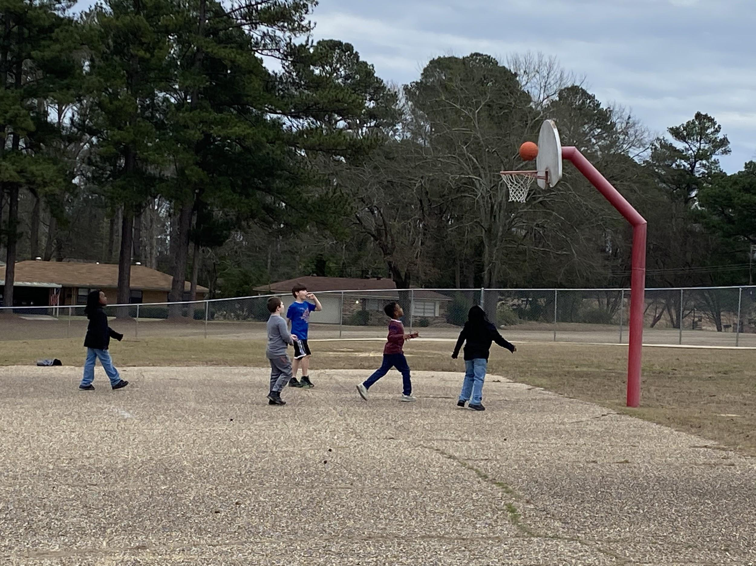
10. Early Demonstration of talents in music, art, athletics, or the performing arts

Slide 17
Two ways to Assess a child
Static assessment - determined by what a child already knows according to comparison to norms or set criteria.
Standardized tests, DIBELS, STAR testing, etc.
Dynamic assessment - looks at a child’s ability to acquire or express skills or knowledge during an assessment.
Ongoing, informal, formative, messy
Observation documentation - Doesn’t need to have all characteristics
Portfolio - Pictures, video, products, etc.

